Slide 1
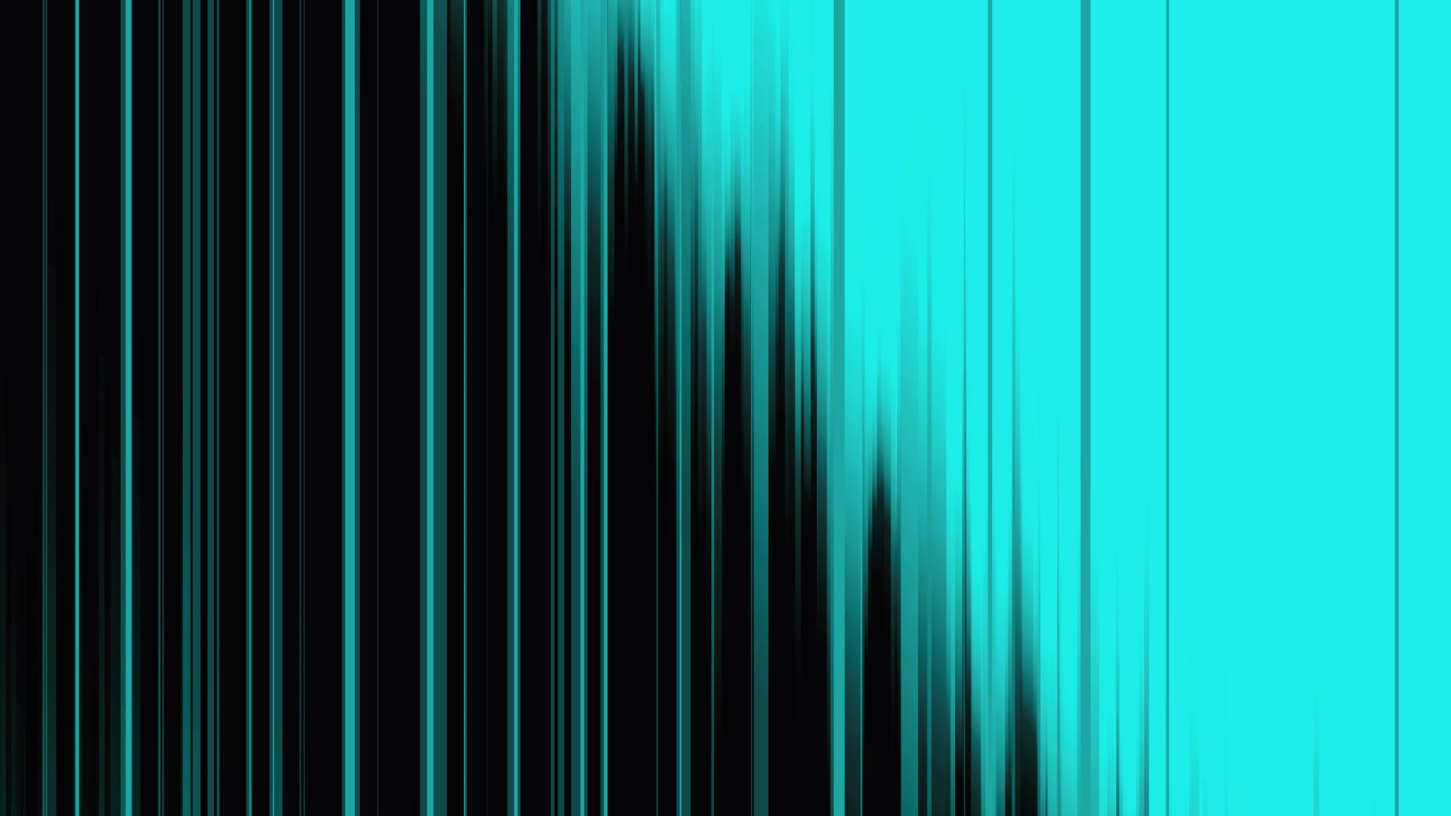
ESP32 with DHT22
Measure pressure and humidity with an ESP32

Slide 2
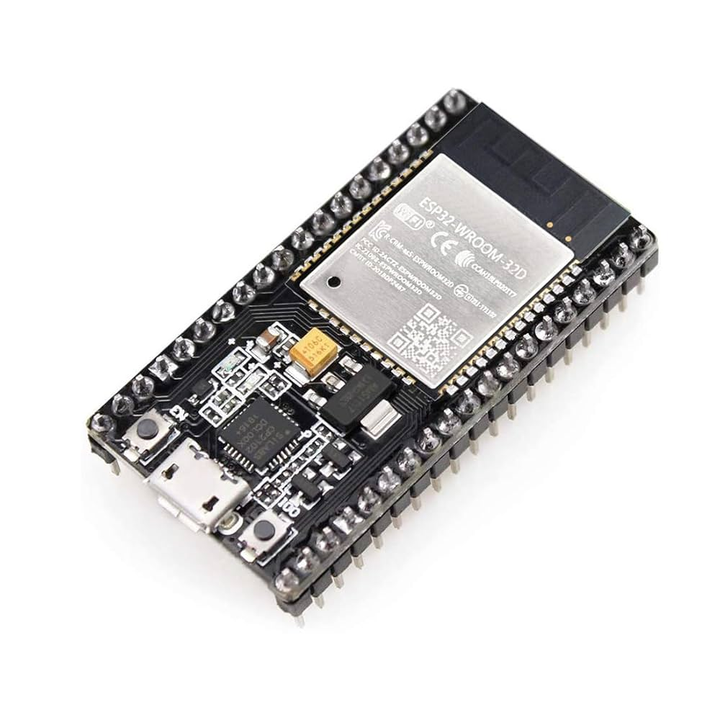
What can you do with an ESP32?
IOT devices – Wi-Fi, Bluetooth
BattleBots – check out the UMass Robotics Club
Motors – make things move
Sensors – sense the world around you (we’ll do this today)
Light Displays – control LEDs
Addressable LEDs – WLED, FastLED, Neopixel
Mini Servers – for, you know, server stuff

Slide 3
IDE and Library Installation
Option 1 (suggested for new users):
Download and install Arduino IDE: https://www.arduino.cc/en/software/
Option 2 (for VS Code users):
In Microsoft VS Code:
Open VS Code Package Manager
Search for the official “platformio ide” extension, and install it
Next step for both options:
Install libraries:
Adafruit Unified Sensor
Adafruit DHT sensor Library

Slide 4
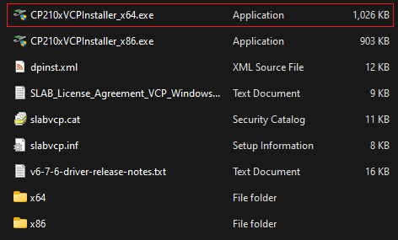
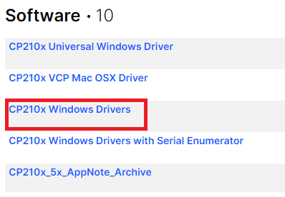
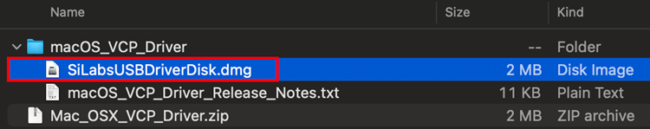
Install drivers for ESP32
Go to: https://www.silabs.com/software-and-tools/usb-to-uart-bridge-vcp-drivers
Download the “CP210x Windows Driver” or “SiLabsUSBDriverDisk.dmg”
Unzip and install the driver
Windows:
MacOS:

Slide 5
Sketch Setup
First, add ESP32 boards to the board types in Arduino IDE
File -> Preferences…
Add the following URL in the field “Additional boards manager URLs:”
https://raw.githubusercontent.com/espressif/arduino-esp32/gh-pages/package_esp32_index.json
In Arduino IDE: File -> Examples -> DHT sensor library -> DHTtester
Note: “DHT sensor library” probably at the bottom of the Examples list
Change the DHTPIN from 2 to 4 (this should be around line 10 in the example code)
#define DHTPIN 4

Slide 6
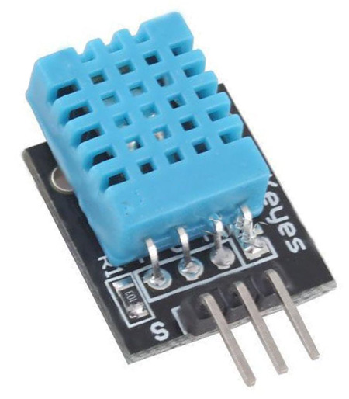
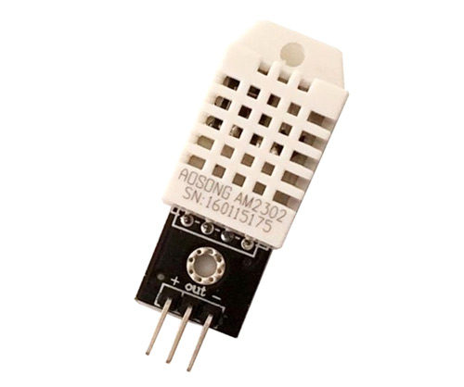
Choose your sensor type
// Uncomment whatever type you're using!
//#define DHTTYPE DHT11 // DHT 11
#define DHTTYPE DHT22 // DHT 22 (AM2302), AM2321
//#define DHTTYPE DHT21 // DHT 21 (AM2301)

Slide 7
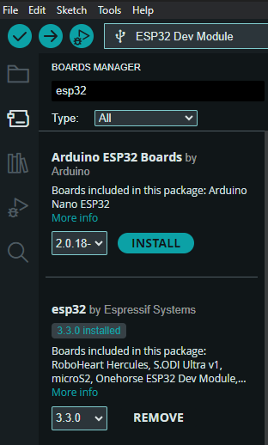
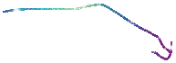
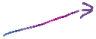
Add ESP32 to “Boards” in Arudino IDE
Click on the Boards Manager
Add the “esp32 by Espressif Systems”

Slide 8
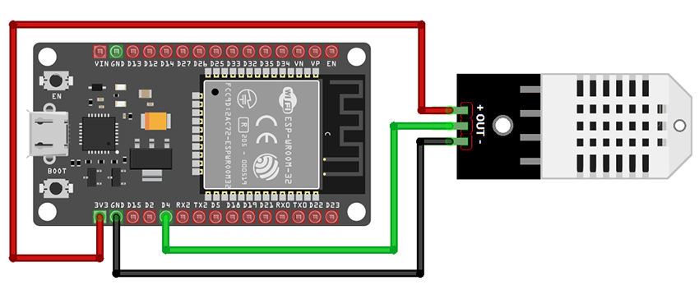
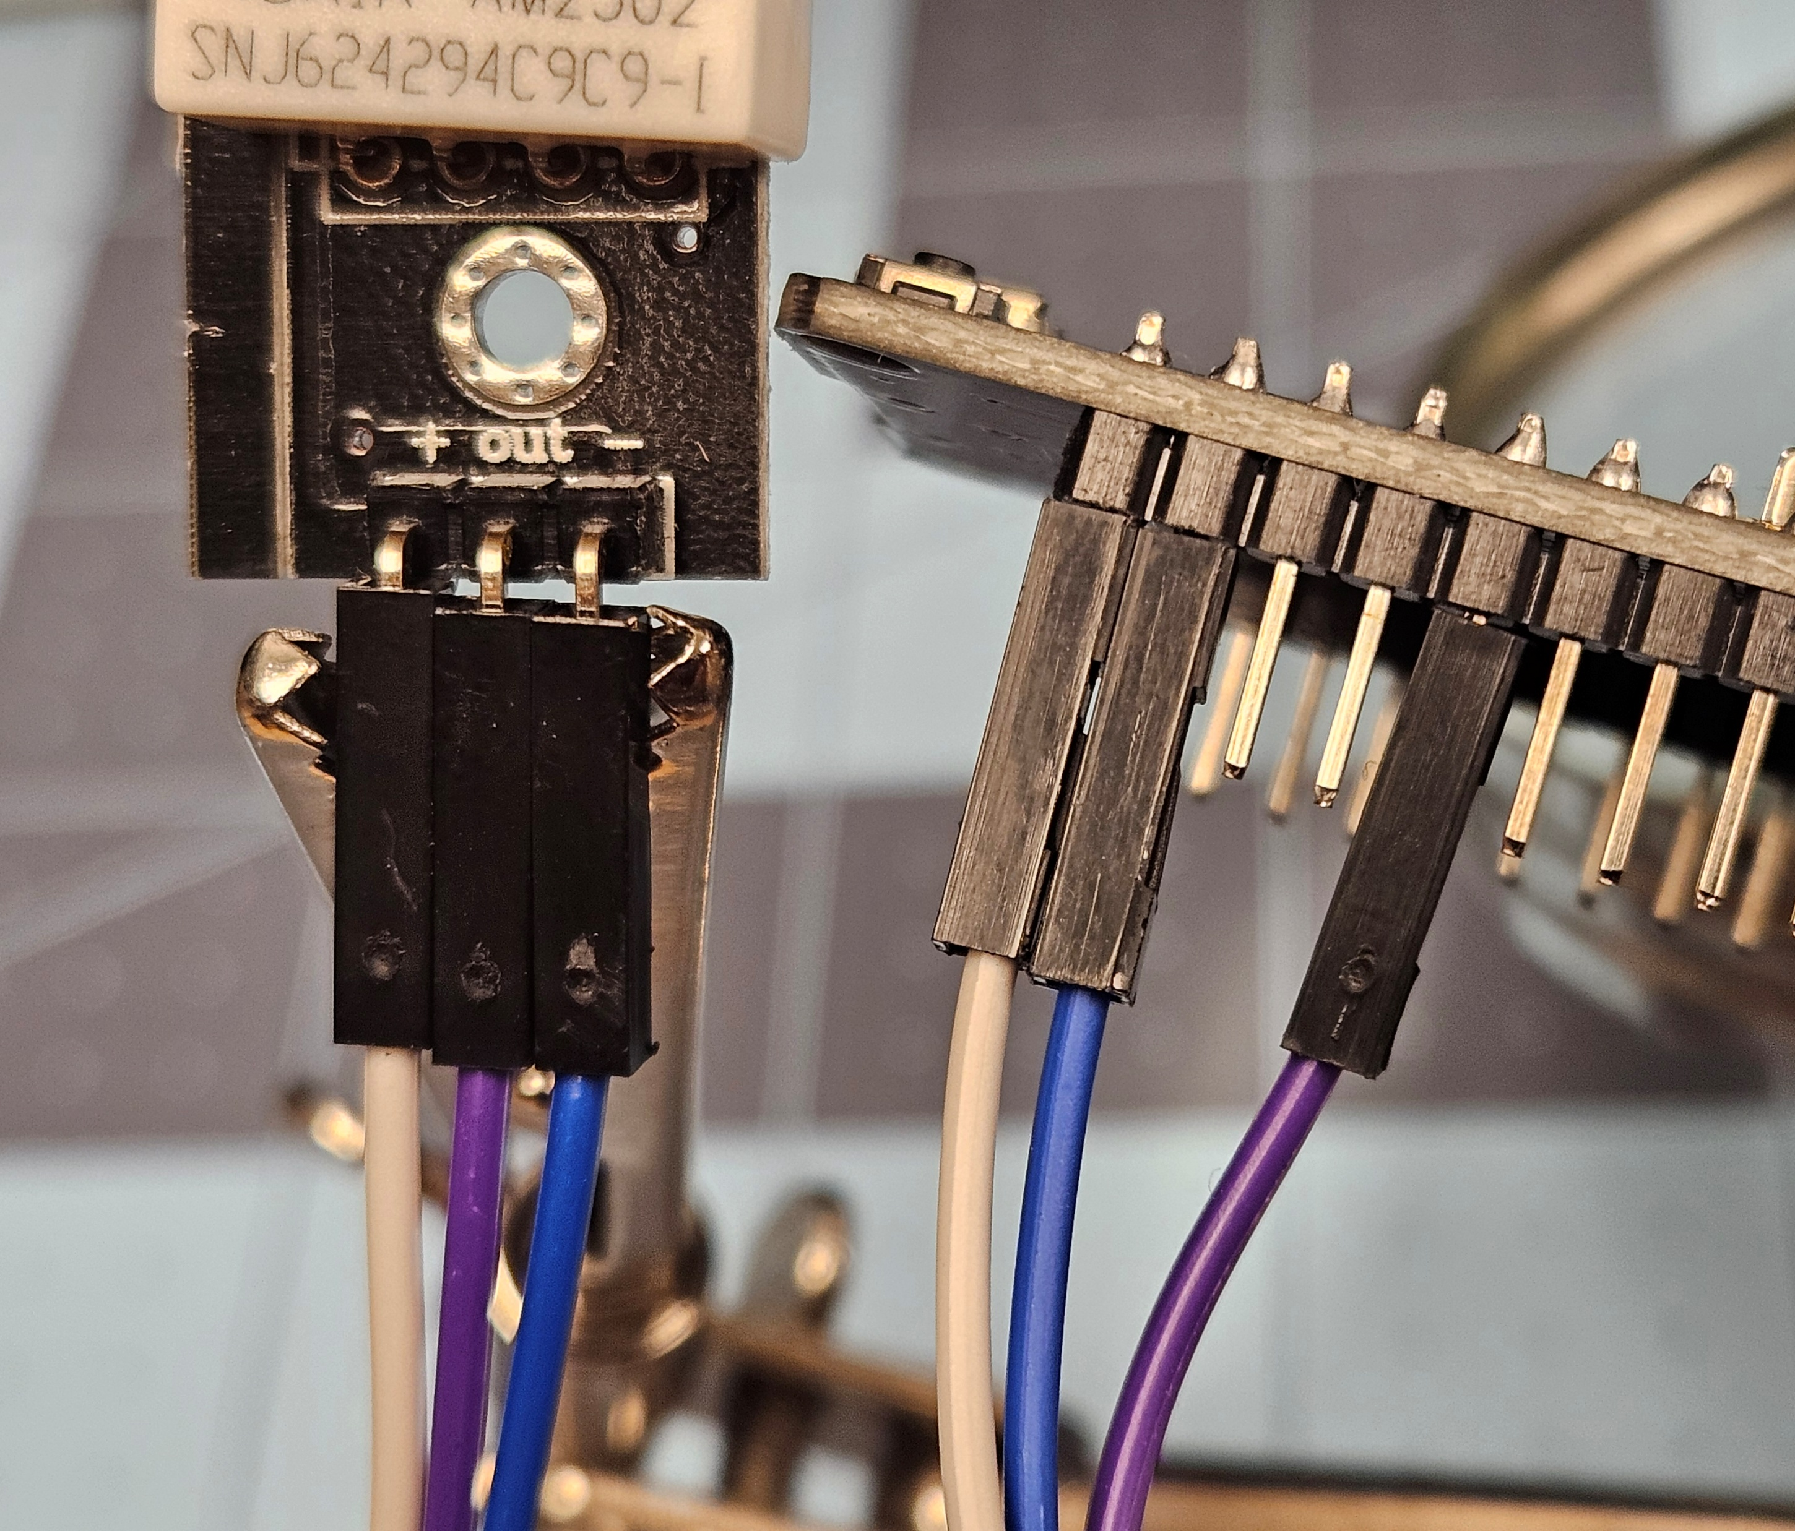
Circuit
Use the Dupont connector wires to connect the following:
+ pin ➔ 3V3 pin on ESP32
OUT pin ➔ D4 pin on ESP32
– pin ➔ GND pin on ESP32

Slide 9
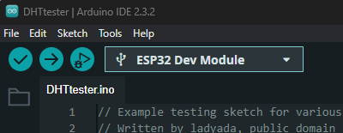
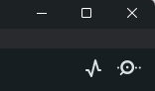

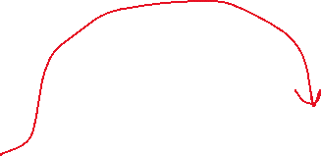

Connect ESP32
Connect the ESP32 to the computer with a USB cable.
Select the board and port in the upper left of the IDE.
The board should be, “ESP32 Dev Module”.
The port is the one that wasn’t there when the ESP32 wasn’t plugged in.
Upload the sketch to the board by pressing the Upload button.
When the sketch is successfully flashed onto the ESP32, press the “Serial Monitor” button in the upper right corner of the Arduino IDE to read the data from the ESP32 in the IDE’s terminal.

Slide 10
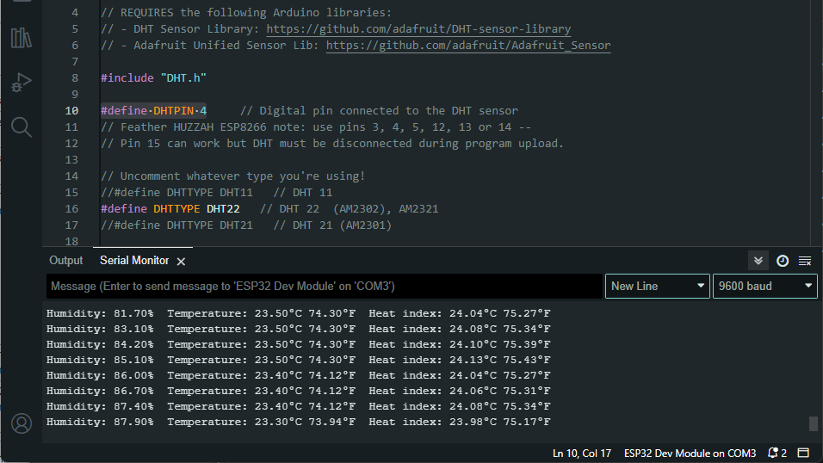

Slide 11
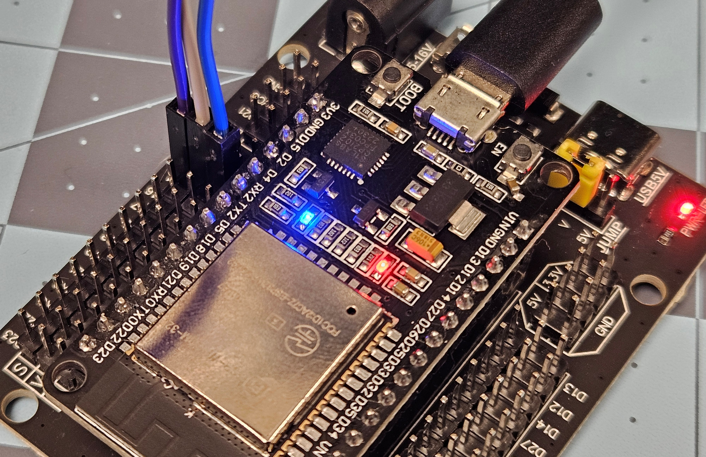
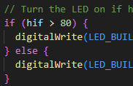
Next
From https://github.com/PhysCompMakerspace/ESP32-DHT22
Download DHT_Tester_wLED.ino
This incorporates the built-in LED on the ESP32 that is internally connected to GPIO pin 2. If the heat index rises above 80°F, then the LED turns on, otherwise it’s off.
Download ESP32_serial_reader.py
This allows you to read the serial data sent by the ESP32 with python. Only one serial connection can connect to the ESP32 at a time. If you’ve used the serial monitor in Arduino, then close that before running this program.

Slide 12
Next Steps
Explore other digital and analog sensors: light, color, pressure, sound, motion, etc.
ESP32 can communicate over Wi-Fi or Bluetooth
WLED project – addressable LEDs
IOT with ESPHome and Home Assistant
Motor control: brushed, brushless, servo, stepper
MIDI

